Slide 1
ADVANCED SORTING AND SEARCHING
KARTHIK SUBRAMANIAN

Slide 2
Algorithmic efficiency
The algorithms for sorting discussed earlier - Bubble sort, selection sort and insertion have complexity O(n²).
There are more advanced algorithms namely - Quick Sort, Merge Sort, and Heap Sort that provide more efficient sorting.

Slide 3
Quick Sort
Quick Sort works by partitioning the array with a pivot element. To do this, the pivot element is moved to the correct position of the array.
Once this is done, the remaining two subarrays - one to the right and one to the left of the pivot element are sorted in the same manner using recursive call.

Slide 4
Quick Sort- Algorithm
Partition
Input array arr[], low, high
Select pivot = high
Select second pointer i = low-1
Iterate j from low to high-1
If arr[j]<=pivot
i++
Swap(arr[i], arr[j])
i++
Swap(arr[i],arr[high])
Return i

Slide 5
Quick Sort- Algorithm
QuickSort
Input array arr[], low, high
If low<high
pivot = partition(arr, low, high)
QuickSort(arr, low, pivot-1)
QuickSort(arr, pivot+1, high)

Slide 6
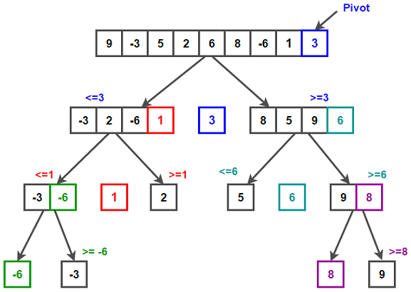
QuickSort - Diagram

Slide 7
QuickSort
The average complexity is O(nlog(n))
The worst case is O(n2) and best case is O(nlog(n))

Slide 8
Merge Sort
Divide: Divide the list or array recursively into two halves until it can no more be divided.
Conquer: Each subarray is sorted individually using the merge sort algorithm.
Merge: The sorted subarrays are merged back together in sorted order. The process continues until all elements from both subarrays have been merged.

Slide 9
Merge Sort- Algorithm
Divide
Input array arr[], size N
If N = 1 return
Else mid = N/2
Return two arrays arr1[0..mid-1] and arr2[mid…N-1]

Slide 10
Merge Sort Algorithm
Merge
Input two arrays arr1[0..N1] and arr2[0…N2]
Set empty array arr[]
set i = 0, j = 0, k = 0
iterate while i<N1 and j<N2
If arr1[i]<=arr2[j]
arr[k]= arr1[i]
k++
i++
Else
arr[k]=arr2[j]
k++
j++
if(i==N1)
Iterate while j <N2
arr[k]= arr[j]
k++
j++
Else
Iterate while i<N1
arr[k] = arr[i]
k++
i++
Return merged array arr[]

Slide 11
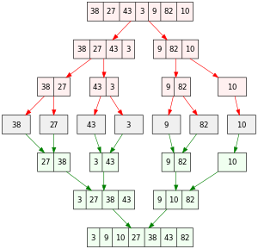
Merge Sort

Slide 12
Heap Sort
To sort an array using heap sort, convert it into a max heap
For a max heap, the parent node is always greater than or equal to its child nodes. For instance for an array arr[0,1…N], the left node for an index i is 2*i+1 and the right node is 2*i+2.
Once we convert it to a max heap, swap the 0th index with the last index and we are having the smallest element at root index.
Continue with the heapify for remaining indices and return the sorted array.

Slide 13
Heap Sort - pseudocode
Heapify
Input array arr[], number of elements N, root node i
largest = i
left = 2*i+1
right = 2*i +2
If left < N and arr[largest] < arr[left]
largest = left
If right <N and arr[largest] <arr[right]
largest = right
If largest is not i
Swap(arr[largest], arr[i])
heapify(arr, N, largest)

Slide 14
Heap Sort - Pseudocode
Heap Sort
Input array arr[], size N
Iterate from i = N/2 -1 to 0
Call heapify(arr[], N, i)
Iterate from i = N-1 to 0
swap(arr[0], arr[i])
Call heapify(arr[], i, 0)

Slide 15
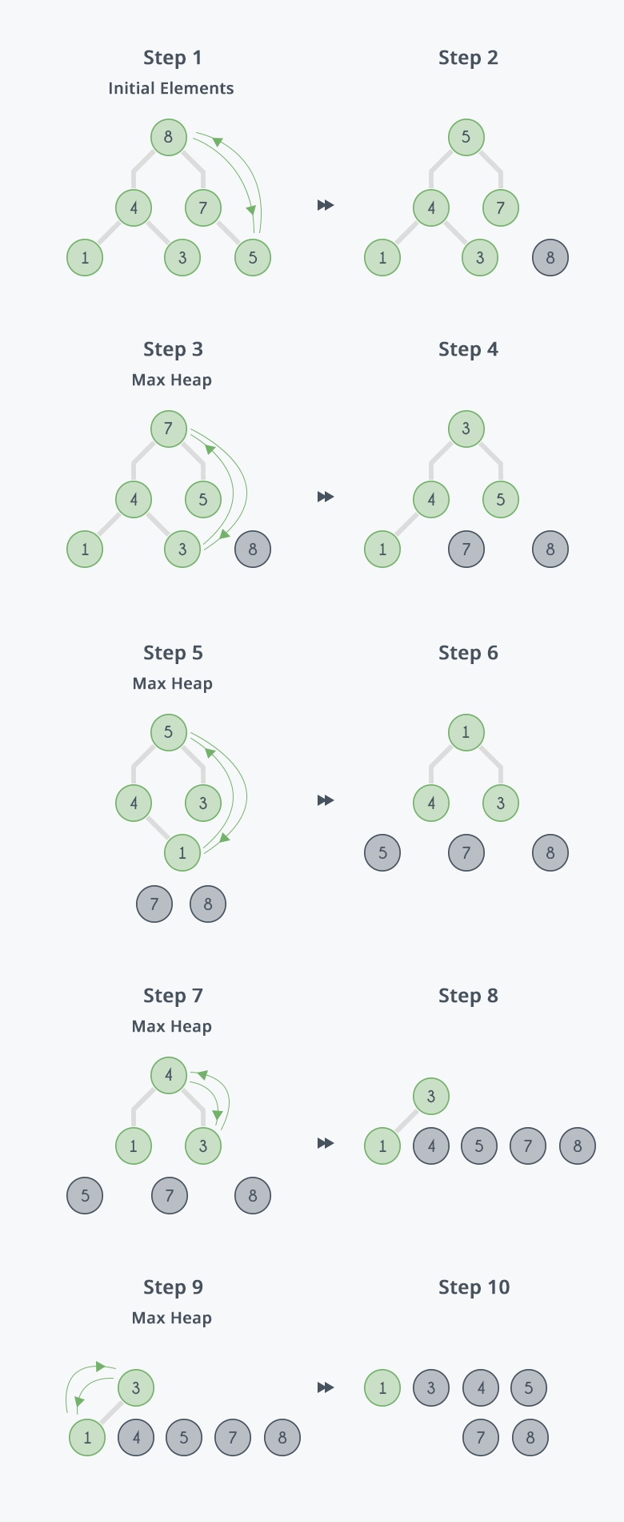
Heap Sort

Slide 16
ADVANCED SEARCHING TECHNIQUES

Slide 17
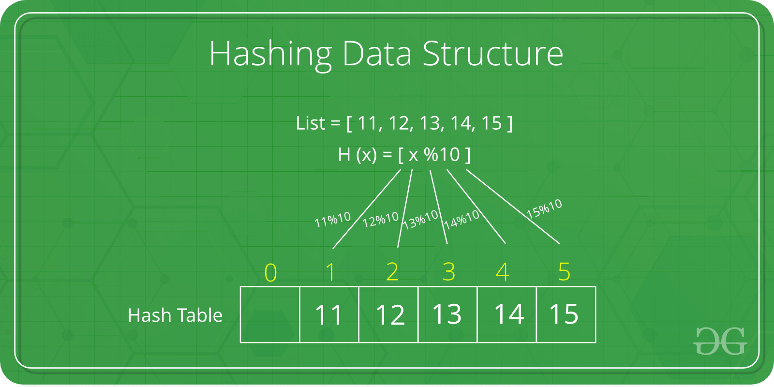
Hashing
Hashing is based on the principle of storing a list of key, value pairs in a data structure.
Example, lets say we have to store the hash table with value list as shown below:

Slide 18
Hashing
The hash function is a function that takes a key and returns an index into the hash table. The goal of a hash function is to distribute keys evenly across the hash table, minimizing collisions (when two keys map to the same index).
Common hash functions include:
Division Method: Key % Hash Table Size
Multiplication Method: (Key * Constant) % Hash Table Size
Universal Hashing: A family of hash functions designed to minimize collisions

Slide 19
Hashing
The hash function is used to map the entities of the key list to the value list as shown below.
Jack Mike Raj
1 2 5

Slide 20
Binary Search Trees
A Binary Search Tree is a data structure used in computer science for organizing and storing data in a sorted manner.
Each node in a Binary Search Tree has at most two children, a left child and a right child, with the left child containing values less than the parent node and the right child containing values greater than the parent node.
This hierarchical structure allows for efficient searching, insertion, and deletion operations on the data stored in the tree.

Slide 21
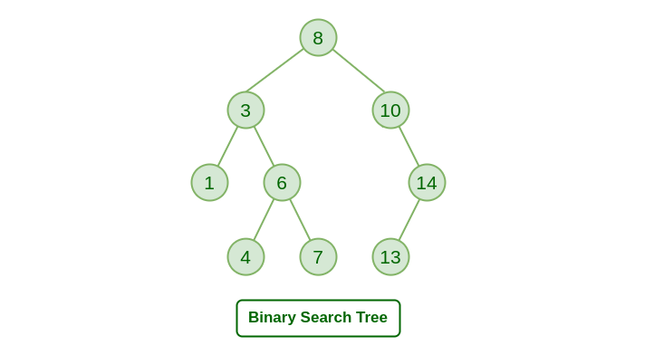
Binary Search Tree

Slide 22
Binary Search Trees - Insertion algorithm
Insertion algorithm is a recursive call whenever there are pre-existing elements in the BST. If no elements exist, the new node is created and a pointer to that is returned.
Insert key into BST node
If node is NULL return newNode(key)
If key< value at node
Insert key at BST leftNode of node
Else if key> value at node
Insert key at BST rightNode of node

Slide 23
Binary Search Trees - In order traversal algorithm
Traversal of BST is done using an inorder algorithm which has a recursive call.
Inorder_Traversal(node)
If node != NULL
InOrder_Traversal(left node of node)
print key of node
InOrder_Traversal(right node of node)
This prints all the left nodes recursively before printing the current key at the node and then prints all the right nodes recursively.

